Slide 1
Supporting Reading Development at Home
This session provides an opportunity to hear about reading initiatives at RPS, including Listening Comprehension, Picture Book Comprehension, Decodable Readers and Fluency Texts. You will learn how to support and improve your childs at reading at home, the role of fluency in comprehension and how to develop a love of reading.

Slide 2
Why should I read with and to my child at home?
Research shows that reading aloud to your child is the single most important thing you can do to prepare your child for reading and learning
Models what good reading sounds like
Nurtures a love of reading of good quality literature
Strengthens bonds with your child
Develops oral language through discussion
Builds background knowledge and understanding through factual texts
Expands their vocabulary
Learn more about interests and hobbies

Slide 3
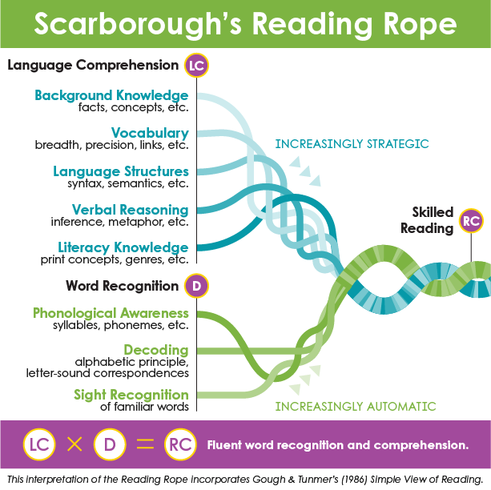
Research – How do children learn to read?
Scarborough’s Reading Rope characterises reading comprehension as two essential components—word recognition and language comprehension

Slide 4
Research – How do children learn to read?
Word recognition
Phonological awareness (working toward phoneme level, or phonemic awareness)
Decoding (phonics and advanced decoding skills)
Sight recognition (building reading automaticity and fluency
These strands work together as the reader becomes accurate, fluent, and increasingly automatic with repetition and practice.

Slide 5
Research – How do children learn to read?
Language Comprehension
Background knowledge (content and conceptual understandings)
Vocabulary (breadth, depth, and relationships among words)
Language structures (understanding and use of a variety of grammatical structures, sentence types, etc.)
Verbal reasoning (inference, logical arguments, literary devices, etc.)
Literacy knowledge (print concepts, genre, etc.)

Slide 6
Dialogic Reading "Having a conversation about books"
Dialogic reading involves an adult and child having a dialogue around the text they are reading aloud together. It involves interactive, shared book reading and conversation about the book using a set of prompts to explicitly develop and extend a student's oral vocabulary and listening comprehension skills.
Dialogic reading works. Children who have been read to dialogically are substantially ahead of children who have been read to traditionally on tests of language development. Children can jump ahead by several months in just a few weeks of dialogic reading.
When most adults share a book with a preschooler, they read and the child listens. In dialogic reading, the adult helps the child become the teller of the story. The adult becomes the listener, the questioner, the audience for the child. No one can learn to play the piano just by listening to someone else play. Likewise, no one can learn to read just by listening to someone else read. Children learn most from books when they are actively involved.
The English language has a rather complicated sounds system, and this must be taught explicitly for all children to be able to read fluently. The 'decodability' of books will change as children progress and increase their knowledge of the code.
Dialogic Reading: An Effective Way to Read Aloud with Young Children | Reading Rockets
https://www.readingrockets.org/topics/early-literacy-development/articles/dialogic-reading-effective-way-read-aloud-young-children

Slide 7
Dialogic Reading "Having a conversation about books"
The fundamental reading technique in dialogic reading is the PEER sequence. This is a short interaction between a child and the adult.
The adult:
Prompts the child to say something about the book,
Evaluates the child’s response,
Expands the child’s response by rephrasing and adding information to it, and
Repeats the prompt to make sure the child has learned from the expansion.
Dialogic Reading: An Effective Way to Read Aloud with Young Children | Reading Rockets
https://www.readingrockets.org/topics/early-literacy-development/articles/dialogic-reading-effective-way-read-aloud-young-children

Slide 8
PEER Example
Example: story – Three Little Pigs
Prompt the child to say something about the book.
Adult: What kind of animal was after the three little pigs?
Child: Wolf.
Evaluate the child’s response.
Adult thinks to self, “Yes, it was a wolf, but we can add more to that response.”
Expands the child’s response.
Adult: Yes, it was a big, bad wolf!
Repeat the prompt.
Adult: What kind of animal was after the three little pigs?
Child: A big, bad wolf
Dialogic Reading: An Effective Way to Read Aloud with Young Children | Reading Rockets
https://www.readingrockets.org/topics/early-literacy-development/articles/dialogic-reading-effective-way-read-aloud-young-children

Slide 9
Dialogic Reading "Having a conversation about books"
There are five types of prompts that are used in dialogic reading to begin PEER sequences. You can remember these prompts with the word CROWD.
Completion prompts
Recall prompts
Open-ended prompts
Wh- prompts - what, where, when, why, and how questions
Distancing prompts
Dialogic Reading: An Effective Way to Read Aloud with Young Children | Reading Rockets
https://www.readingrockets.org/topics/early-literacy-development/articles/dialogic-reading-effective-way-read-aloud-young-children

Slide 10
CROWD Examples
Completion prompts - You leave a blank at the end of a sentence and get the child to fill it in. These are typically used in books with rhyme or books with repetitive phases. For example, you might say, “I think I’d be a glossy cat. A little plump but not too ____,” letting the child fill in the blank with the word fat. Completion prompts provide children with information about the structure of language that is critical to later reading.
Recall prompts - These are questions about what happened in a book a child has already read. Recall prompts work for nearly everything except alphabet books. For example, you might say, “Can you tell me what happened to the little blue engine in this story?” Recall prompts help children in understanding story plot and in describing sequences of events. Recall prompts can be used not only at the end of a book, but also at the beginning of a book when a child has been read that book before.
Open-ended prompts - These prompts focus on the pictures in books. They work best for books that have rich, detailed illustrations. For example, while looking at a page in a book that the child is familiar with, you might say, “Tell me what’s happening in this picture.” Open-ended prompts help children increase their expressive fluency and attend to detail.
Wh- prompts - These prompts usually begin with what, where, when, why, and how questions. Like open-ended prompts, wh- prompts focus on the pictures in books. For example, you might say, “What’s the name of this?” while pointing to an object in the book. Wh- questions teach children new vocabulary.
Distancing prompts - These ask children to relate the pictures or words in the book they are reading to experiences outside the book. For example, while looking at a book with a picture of animals on a farm, you might say something like, “Remember when we went to the animal park last week. Which of these animals did we see there?” Distancing prompts help children form a bridge between books and the real world, as well as helping with verbal fluency, conversational abilities, and narrative skills.
Dialogic Reading: An Effective Way to Read Aloud with Young Children | Reading Rockets
https://www.readingrockets.org/topics/early-literacy-development/articles/dialogic-reading-effective-way-read-aloud-young-children

Slide 11
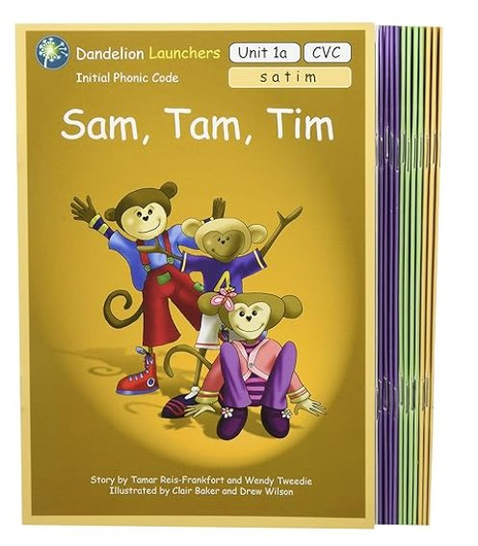
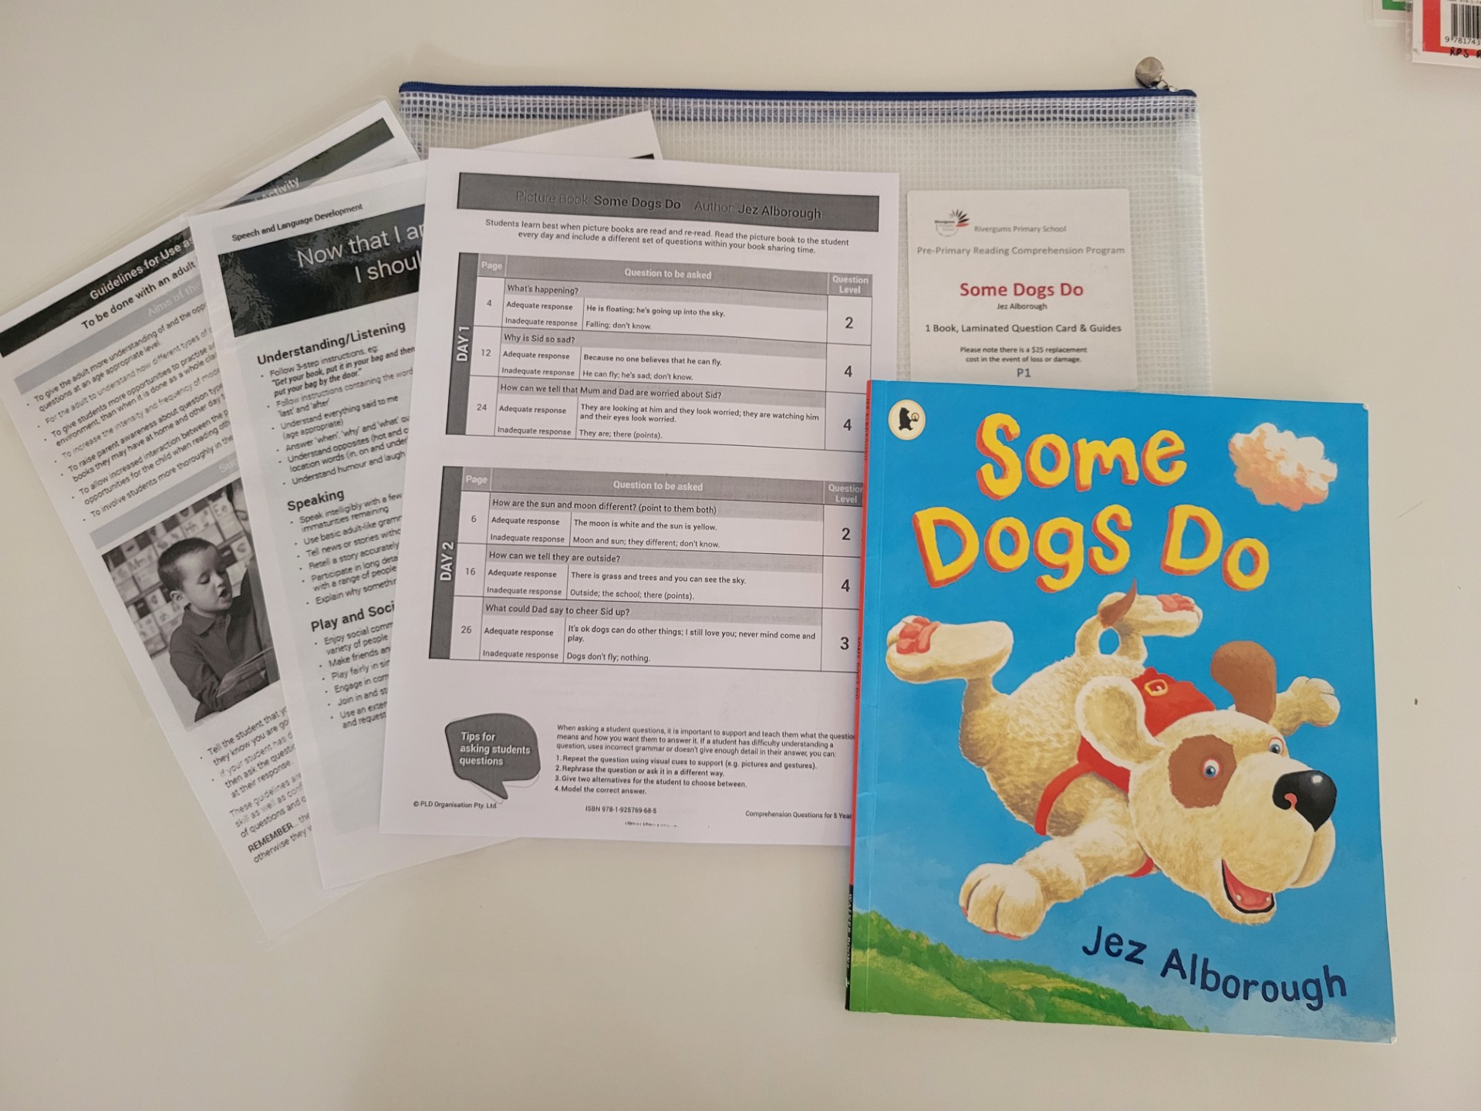
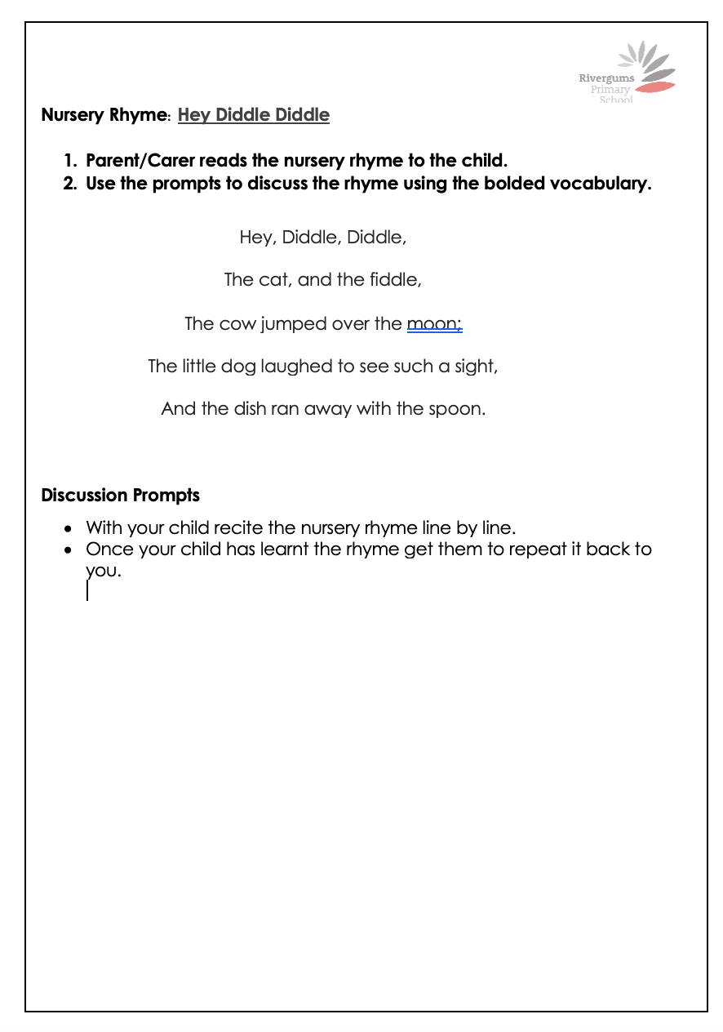
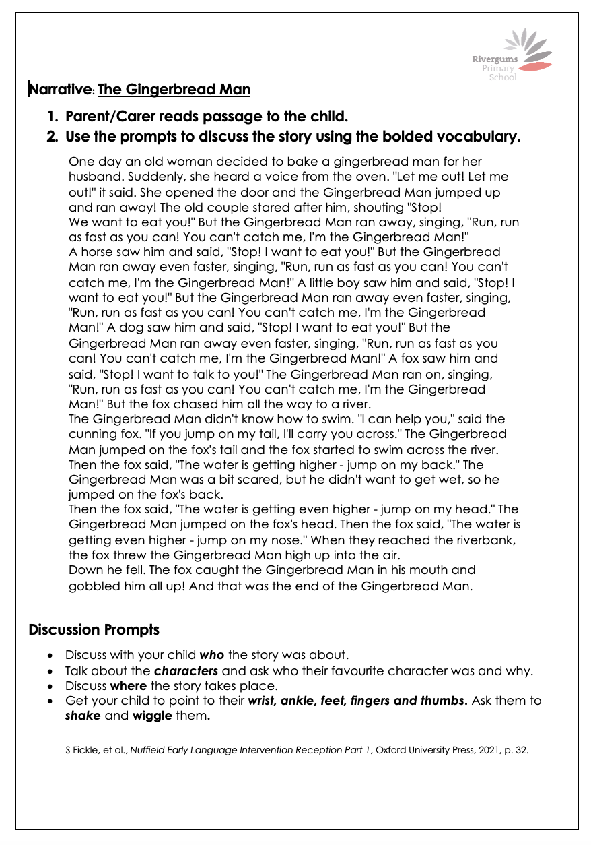
Dialogic Reading Kindy and Pre-primary
Homework Helper for Parents: Supporting questions and prompts
Students will get:
Oral Listening Comprehension: Short stories or Nursery Rhymes: and
Shared Book Experience: Picture Book with Questions
Decodable reader (if ready PP Semester 2)

Slide 12
Year 1 Decodable Readers
written for beginning readers.
contains the specific grapheme-phoneme correspondences students have learned.
learners use their developing segmenting and blending skills to read words.
encourages children to sound out words using decoding strategies rather than guessing from pictures or predicting.
introduced once beginning readers have learned some grapheme-phoneme correspondences and can blend from left to right.

Slide 13
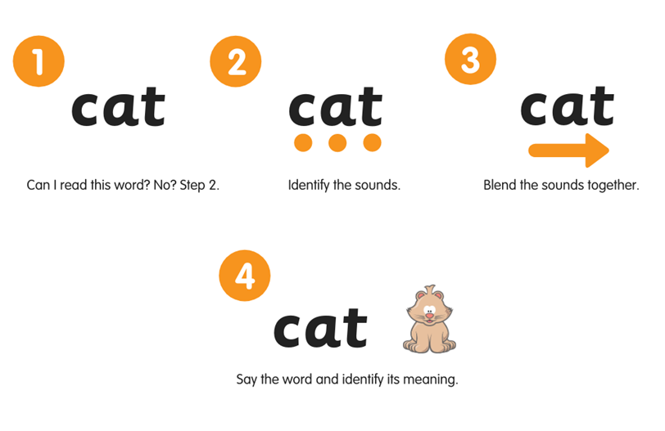
What is phonics?
Phonics instruction connects the phonemes (units of sounds) with written letters so that the reader can transfer knowledge of sounds to the printed word.
This is done through blending sounds together. By Year 1 most students can apply this knowledge to read single sounds and apply more advanced phonics to read.
Reading Science in Schools (RSiS)
Reading Science in Schools (squarespace.com)

Slide 14
Year 1 Decodable Readers
Reading at home
Daily fluency practice includes:
Your child will bring home a decodable reading text in their home reading folder that will focus on sounds they have already learnt to assist in improving their reading fluency.
Read the text to your child during your first read to model what good reading fluency looks like.
Over the week your child will read the same text at least five times. This will help your child focus on their reading fluency using PAVES.
Record each read in their reading diary.
Engage in questioning and discussion before and after oral reading to build student knowledge about the text.

Slide 15
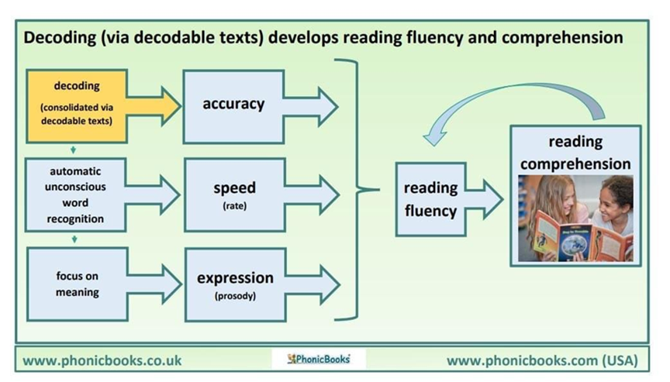
Year 2 – 6 Fluency Texts
It is an important goal for children to become accurate, efficient and fluent readers.
Decoding becomes easy and automatic
Frees up their attention to focus on the meaning of the text
By the end of Year 1 – 60wpm
By the end of Year 2 – 90/100wpm
In Years 3, 4, 5 & 6 110-120+ wpm (with less than 3 errors)
Reading Science in Schools (RSiS)
Reading Science in Schools (squarespace.com)

Slide 17
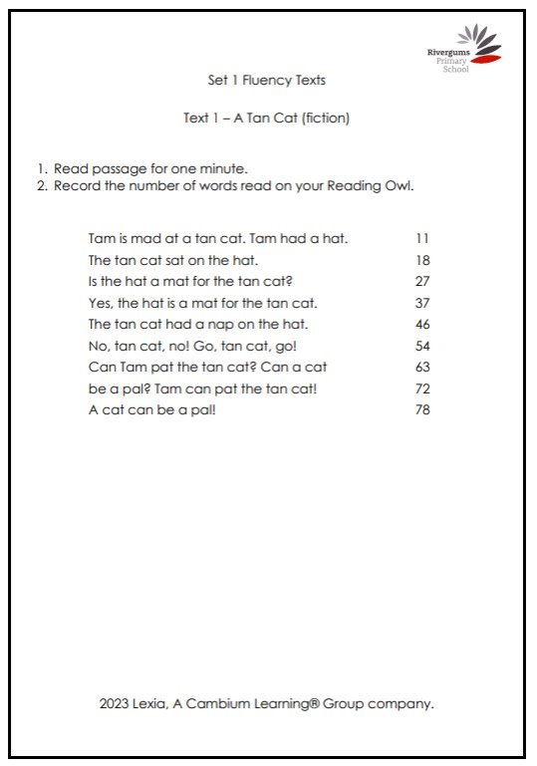
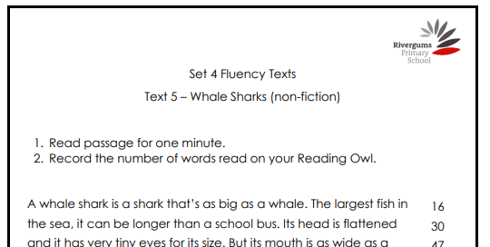
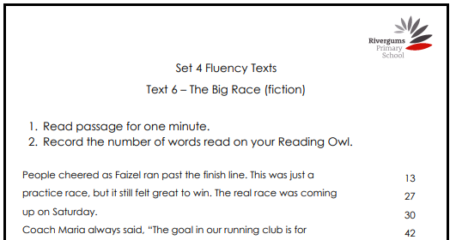
Year 2 – 6 Fluency Texts
Include all types of genres, topics, fiction and non fiction. Newspapers, podcasts, vlogs & blogs.
Include materials related to science, health, mathematics, history, geography, music, art, drama, dance, languages, and other cultures.

Slide 18
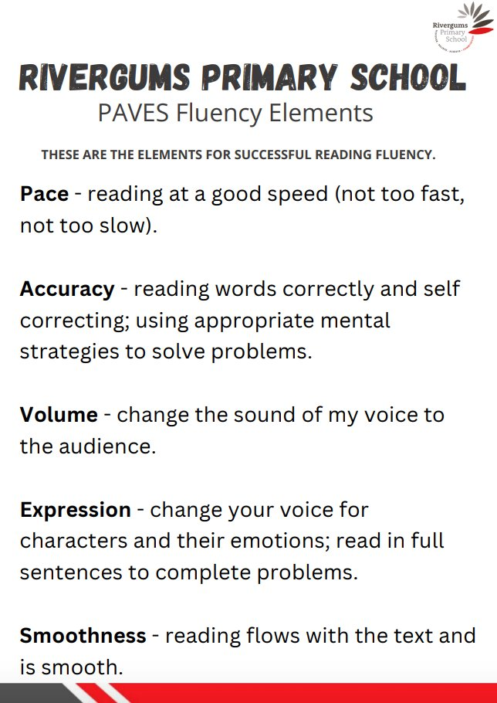
Recording Sheet
Student Diary

Slide 19
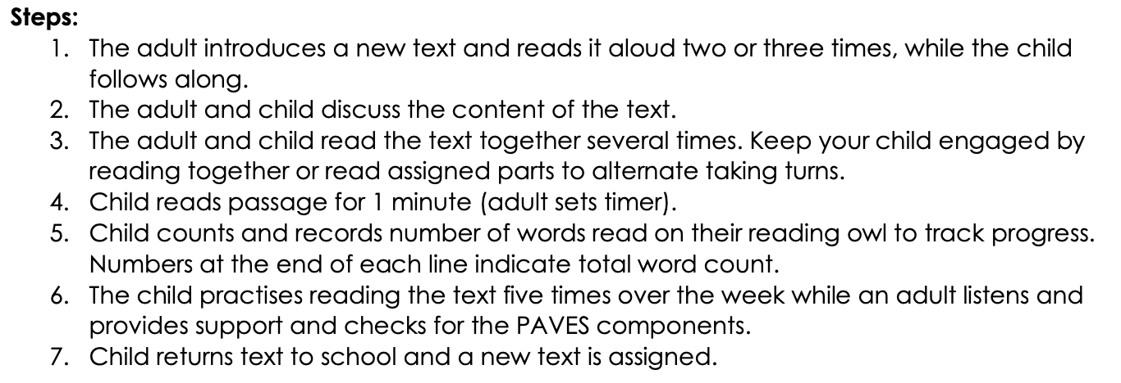
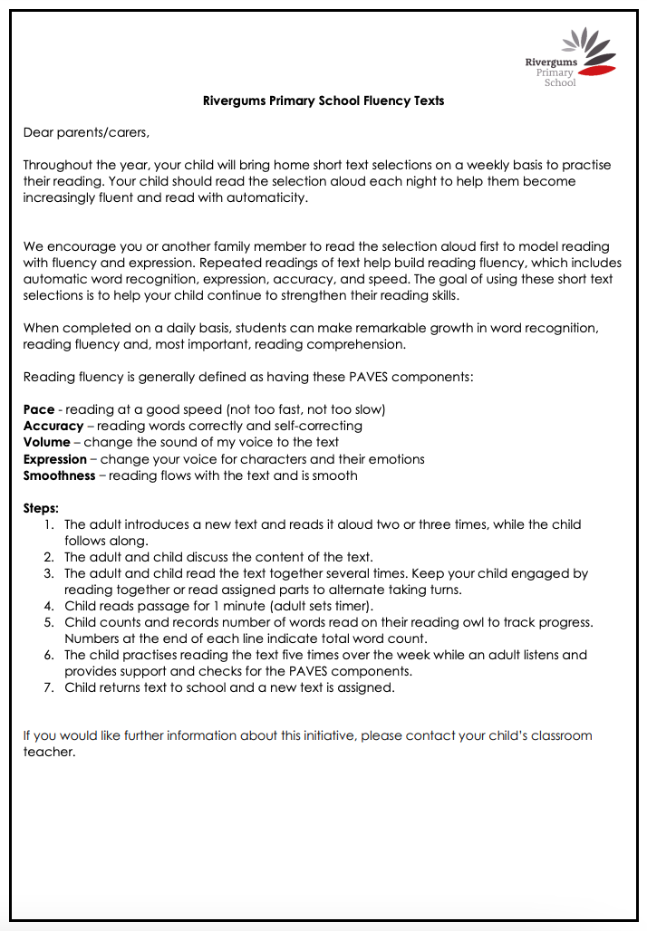
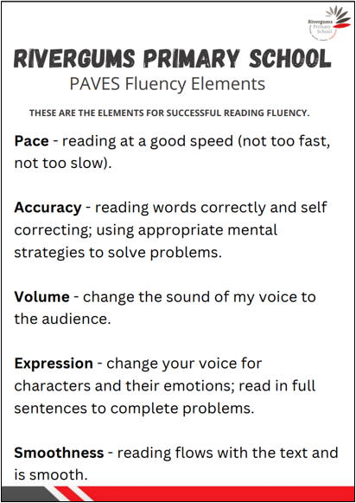
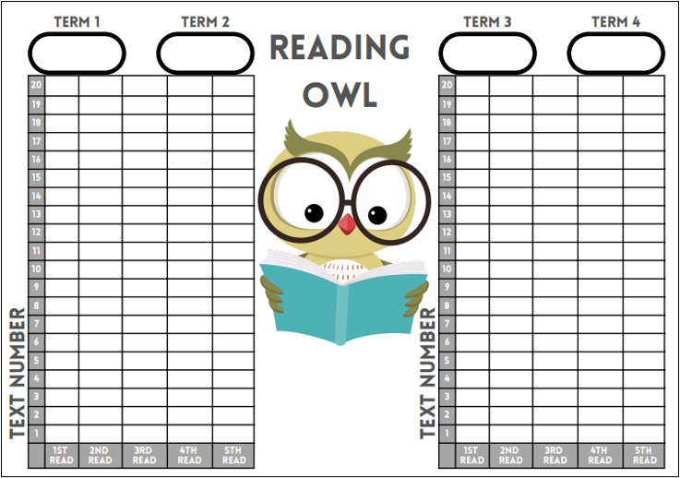
Home Reading Folder
Students will get:
Fluency text
Reading owl recording sheet
Parent letter with steps and PAVES
Student diary

Slide 20
Extending Fluent Readers
Look at ways to extend fluent readers by looking at the language comprehension strands.
Vocabulary – build their knowledge of words, their meaning and word structures.
Comprehension - Discuss and interpret concepts, themes and ideas in texts. Build on background knowledge.

Slide 21
Parent Support in Classrooms
We would love to have you support our students in the classroom with reading. If you are available to read with students, please let the classroom teacher know.

