Slide 1
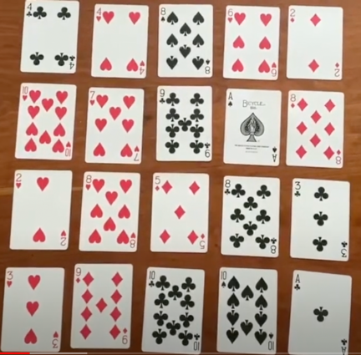
I Spy Objective: To correctly guess the 2-card number sentence of a partner.
Set up
Remove picture cards from the deck.
Shuffle cards.
Lay out 4 rows of 5 cards, 20 cards in total, all facing up.
How to play
Player 1 needs to visualise 2 cards next to each other (vertically, horizontally or diagonally) and add the number up in their head. They will then say “I spy 2 cards that add up to make the sum ____.”
Player 2 then needs to try and pick which 2 cards Player 1 was thinking of. If Player 2 is correctly guesses the cards, they keep those 2 cards.
Swap roles and continue
If the player guesses incorrectly, it immediately goes to the next players turn.
Play continues until all cards have been picked up. The player with the most cards wins.
Adaptations
Multiplication game: Rather than using addition to pair the numbers, students can use their multiplication knowledge. “I spy 2 cards that make the product of _____.”
Difference game: Rather than using addition to pair the numbers, students can use their subtraction knowledge. “I spy 2 cards that have a difference of_____.”

