Slide 1

Odd/Even Snap
Objective: Recognise odd and even numbers
Set up
To start, you will only need the cards numbered 1-10.
Shuffle the deck of cards.
Deal out all the cards into two rows, with five cards in each row. Ensure the cards are face down. Place the remaining cards face down besides the rows.
How to play
Identify player 1 and player 2.
Take turns flipping the cards away from your body, quickly to show the number.
Players race to identify if the number is odd or even.
The first player to call “odd snap” or “even snap” wins the card.
The player who wins the card, replaces the card from the remaining cards on the side.
Continue taking turns until all cards have been used. The player with the most cards in their saved pile is the winner.
Variations
Add cards 11-13 for a challenge once you gave mastered numbers 1-10!
If your child is finding numbers 1-10 tricky to start with only include numbers 1-5 then slowly add 2 extra numbers at a time.

Slide 2
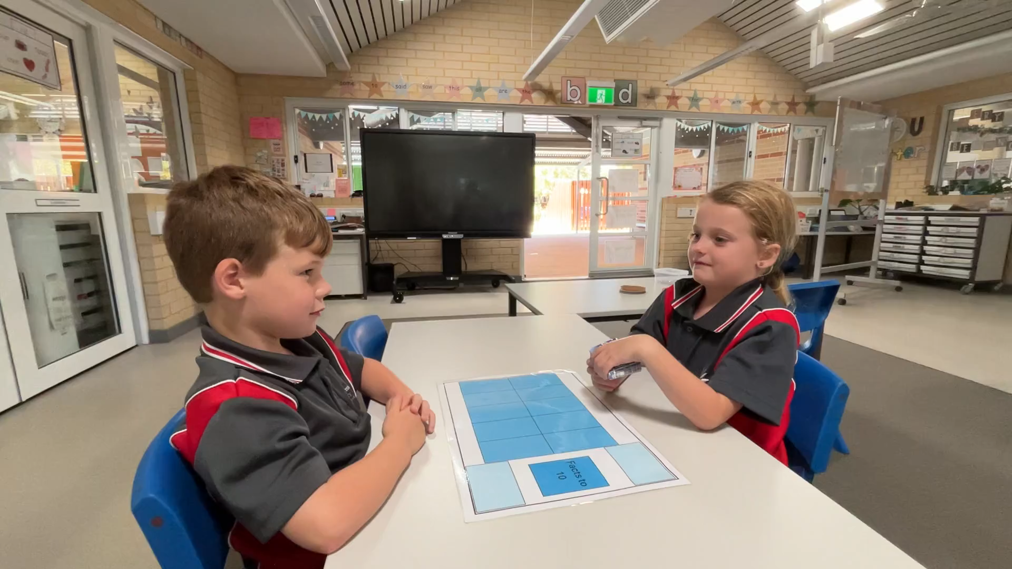
Video 1 of 4

Slide 3
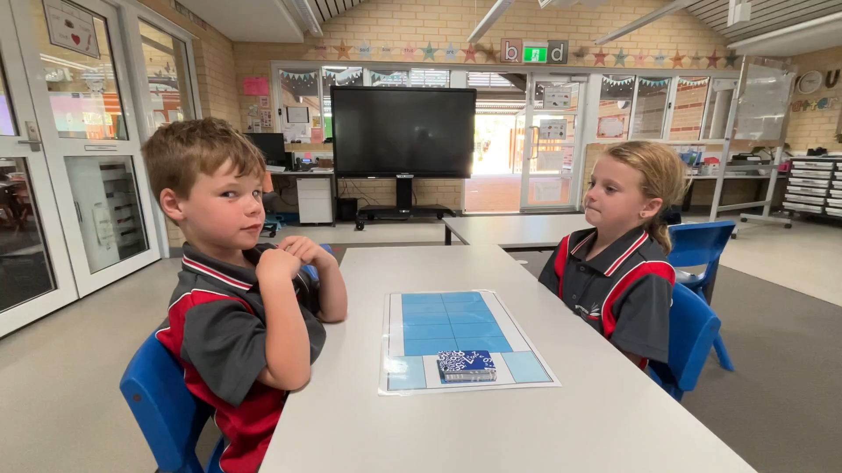
Video 2 of 4

Slide 4
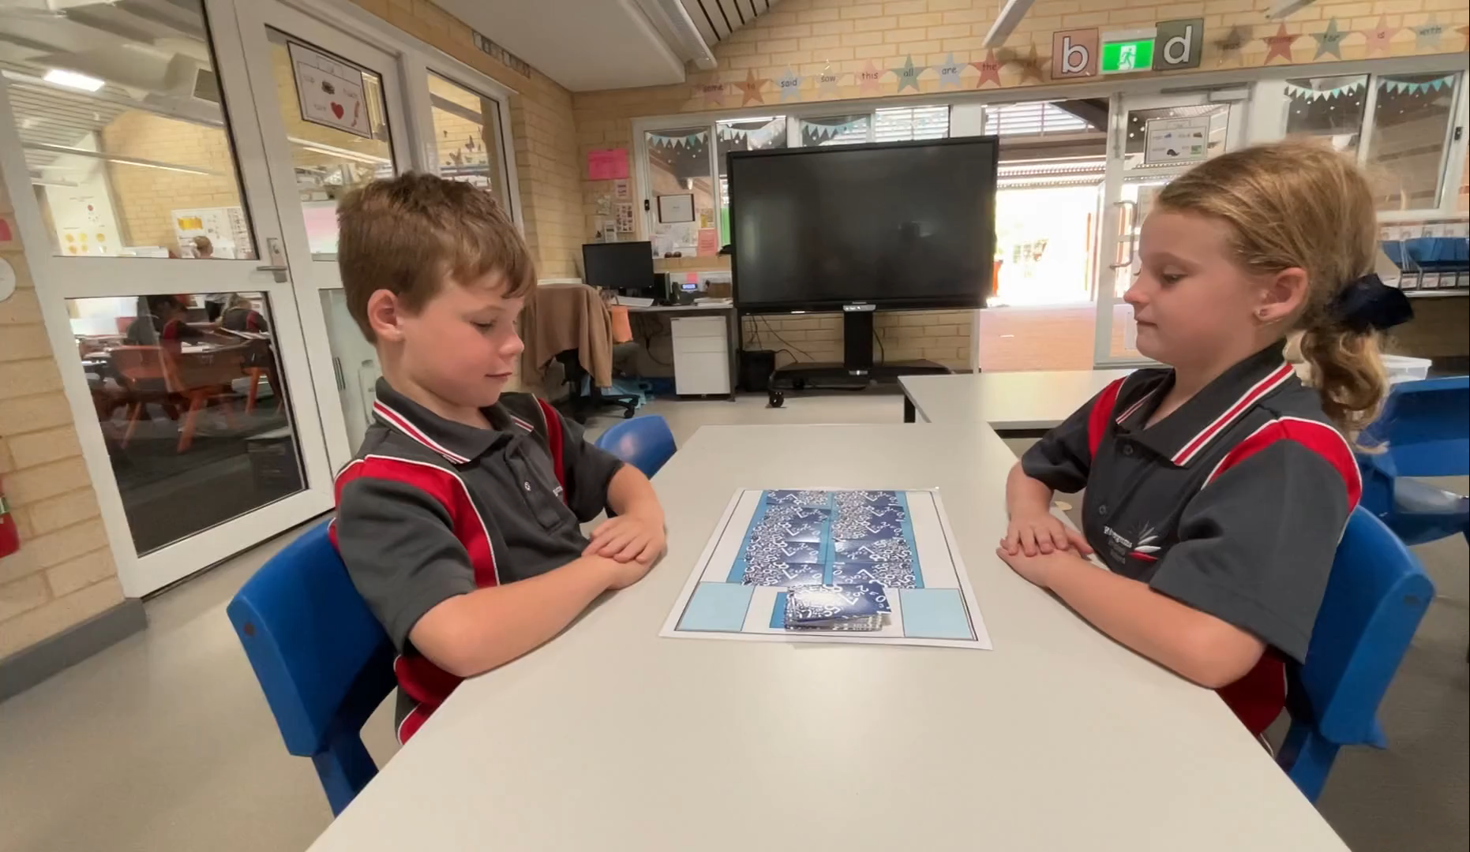
Video 3 of 4

Slide 5
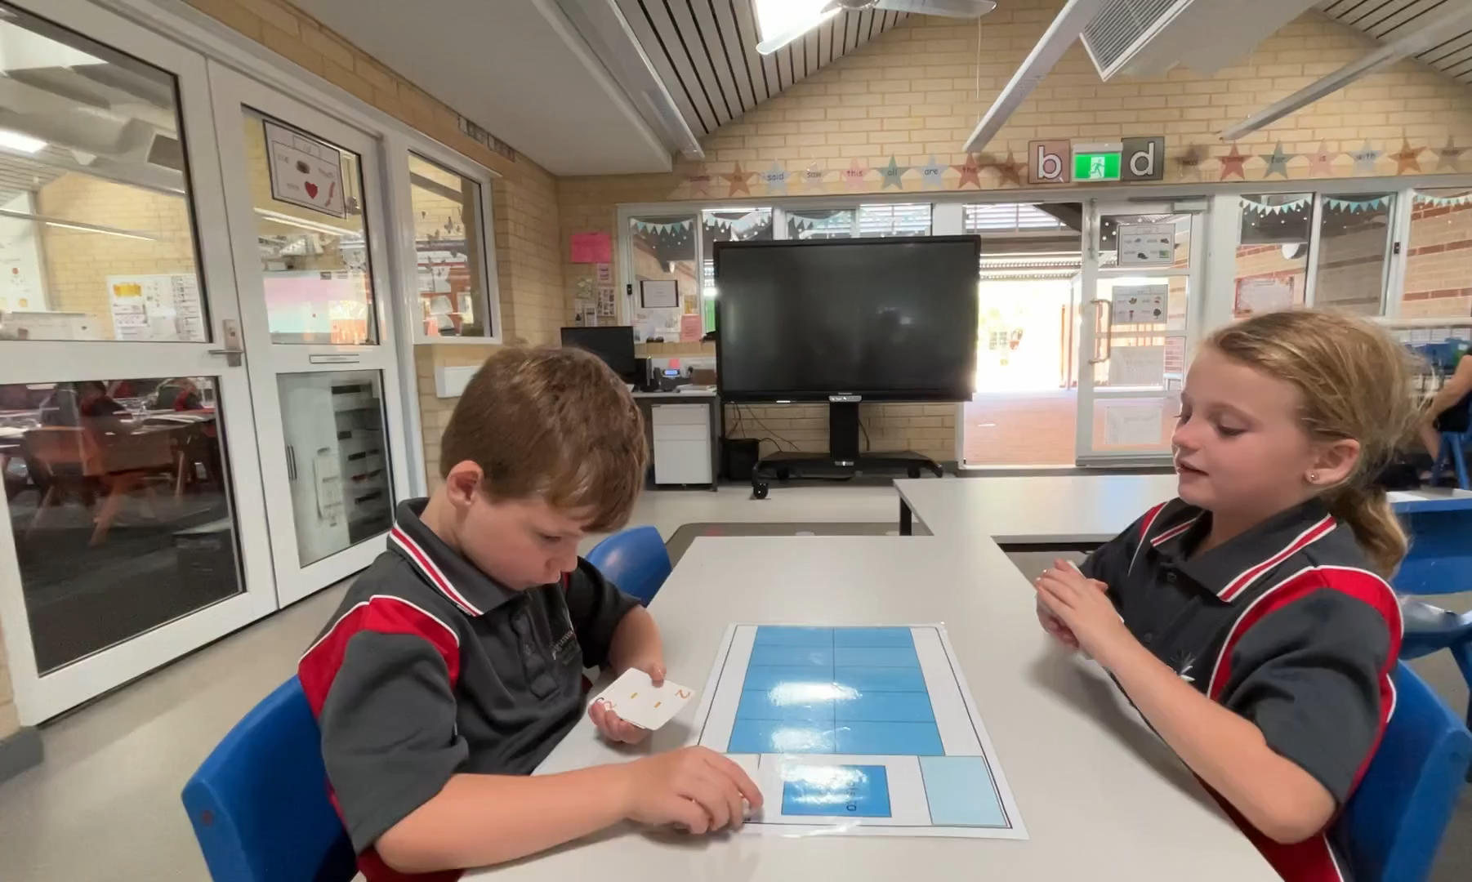
Video 4 of 4

