Slide 1

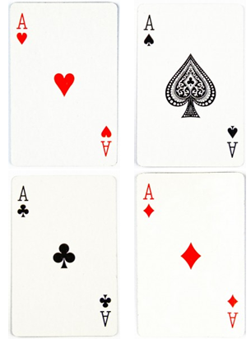
Order of Operation Game
Main objective: To use the Order of Operation technique to solve the sum.
Here’s what you need to know:
How to play this game:
Step 1: Remove all jokers, Kings, Queens and Jacks. We won’t be using them.
Step 2: Set aside all Ace card and make a separate pile.
Step 3: Shuffle the number cards and split them evenly between the two players.
Step 4: Each player draws two number cards and three Ace cards. Arrange them in front of you and write the number sentence on your whiteboard.
Step 5: Solve it! The fastest player to correctly solve the equation wins 1 point. The first player to reach 10 points win the game.
Ace Heart represent Addition Ace Clubs represent Multiplication
Ace Spade represent Division Ace Diamond represent Subtraction

Slide 2
Levels of Play:
Pre-Primary to Year 2 (Beginner Level) Focus on Addition and Subtraction only
Year 3 – 4 (Intermediate level) Focus on all order of operations.
Year 5-6 (Expert level) Focus on all order of operation and double numbers.

Slide 3
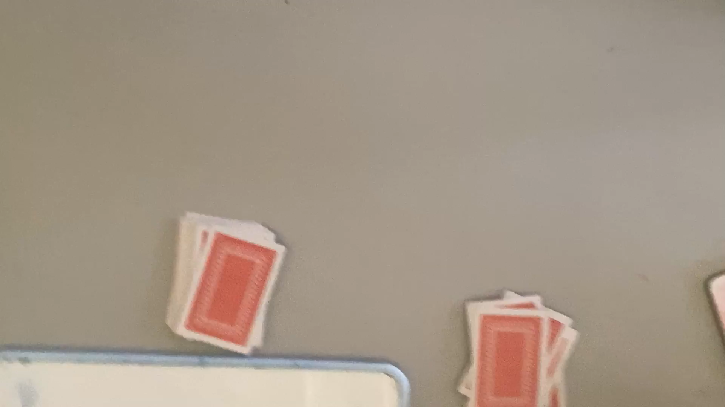
Example 1

Slide 4
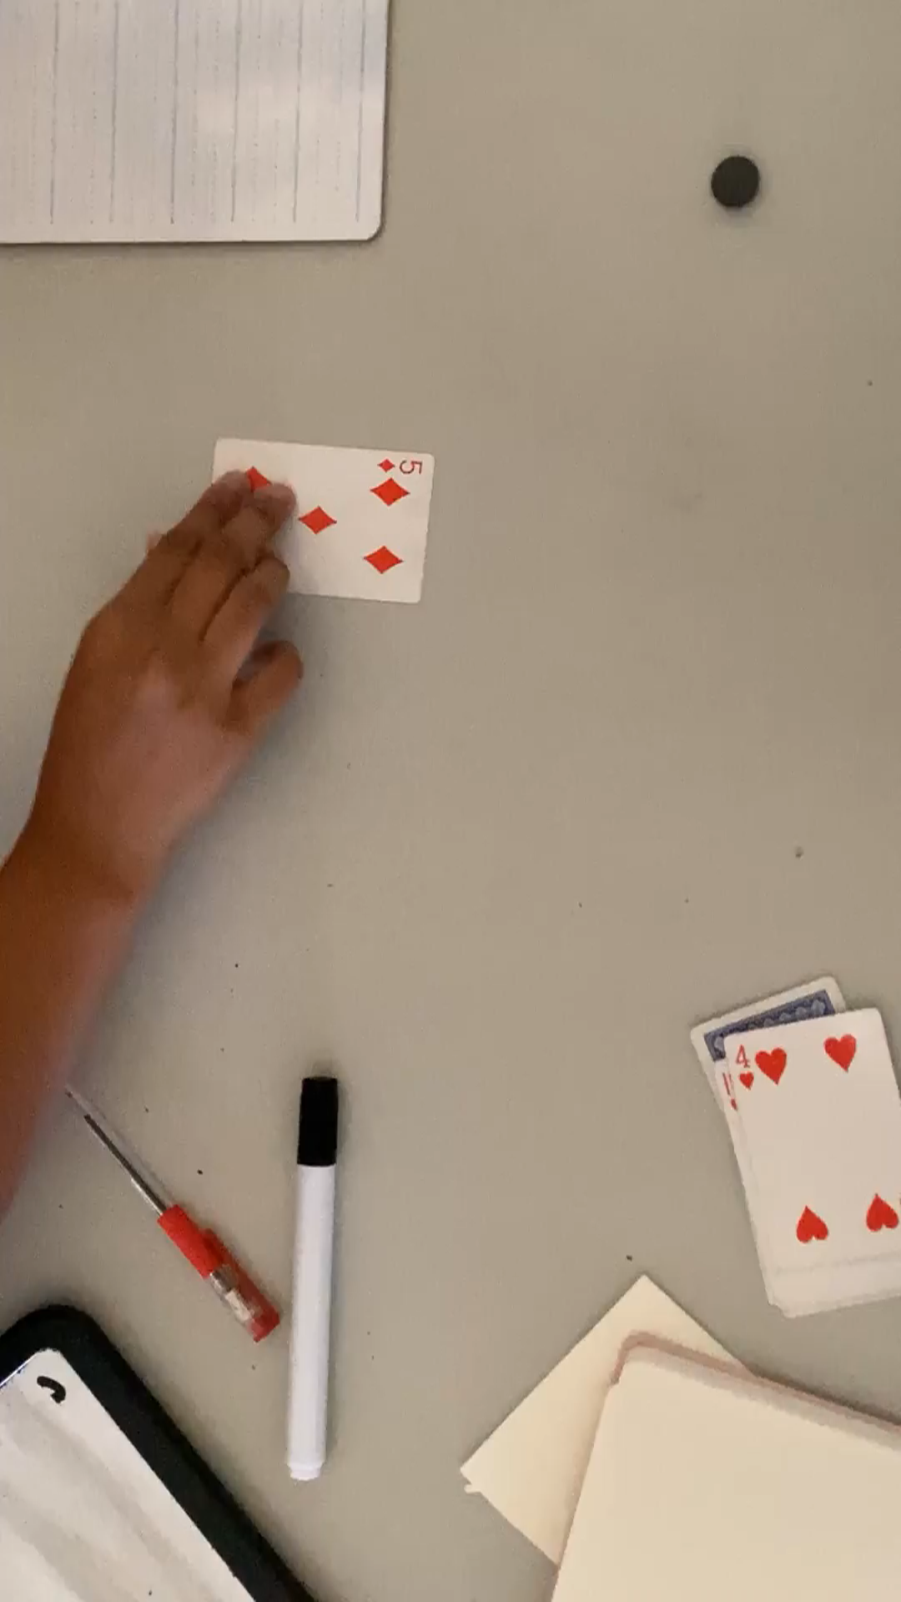
Example 2

